Slide 1
ChIMES ML-IAP
Key Equations

Slide 2
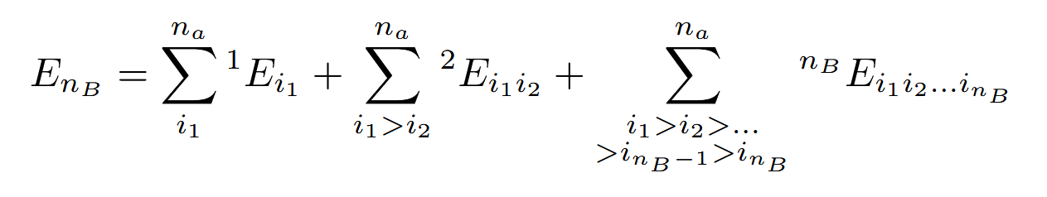

Cluster Expansion
The potential energy of an n-body (n_{B}) system is determined using a many-body cluster expansion
Each summation represents the potential energy associated with all of the subclusters of bodies, that is, the 1-body potentials, 2-body potentials, et cetera
The potential energy can be used to get the force on each particle since $f=−∇U$
Notably this expression is translationally and rotationally symmetric, since only the distance between atoms is used, and not their exact coordinates

Slide 3
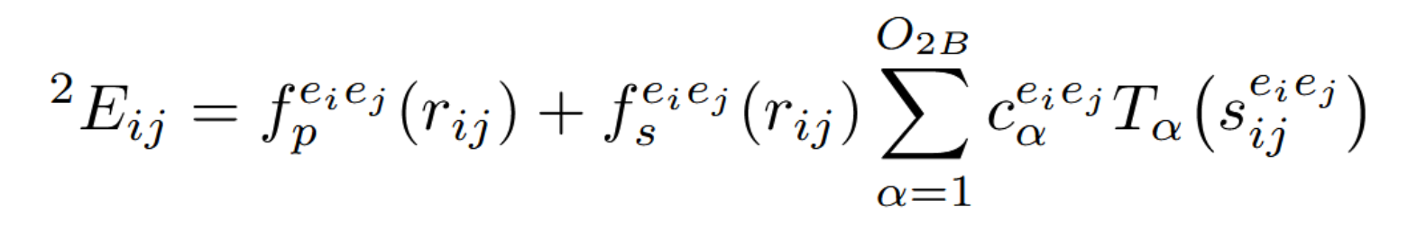

2-Body Interaction Potentials
1-body potentials are taken as constants
2-body potentials are determined using this formula, using a penalty function in combination with a smoothing function
Each parameter is specific to the two atoms in question, $e_{i}$ and $e_{j}$
$T_{α}$ is the Chebyshev polynomial of order $α$. The maximum order $O_{2B}$ is a hyperparameter. The radius needs to be mapped to [-1, 1] as that is the valid domain of the Chebyshev polynomials.
$c_{α}$ is the model coefficient being fit.

Slide 4
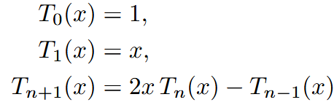
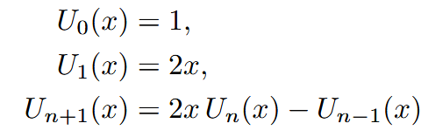

Chebyshev polynomials
There are two types of Chebyshev polynomials, T and U, which can be recursively defined:
The first type is directly used in the total energy calculation, while the second type is used when taking derivatives
Note that the well-behaved domain for $T_{n}\left(x\right)$ is [-1,1]. This means that the distance between two particles cannot be directly passed to this function; it must first be mapped to this range.

Slide 5
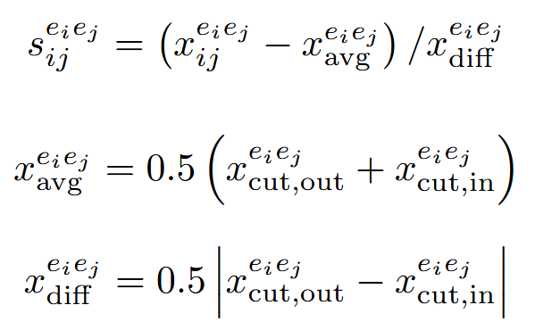

r to s Transformation
Transforming r to s is dependent on the distance cutoffs, $r_{cut,in}$ and $r_{cut,out}$. First an intermediate value $x_{ij}=e^{−\frac{r_{ij}}{λ}}$ is calculated, and from this $s_{ij}$ can be determined. This value is stretches the range of lower-valued interatomic distanced, since the potential energy will be more featured over lower distances.

Slide 6
Higher Body Interaction Potentials
A 3-body potential is given as follows, with higher bodied systems following the same pattern of multiplication across all pairs per each cluster. For example, a 4-body interaction would have 6 terms multiplied:
There is no penalty function required here since the 2-body penalty function already ensures that no 2 bodies are too close to each other, so there can be no clusters of any number that are too close to each other.

Slide 7
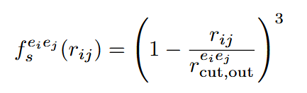
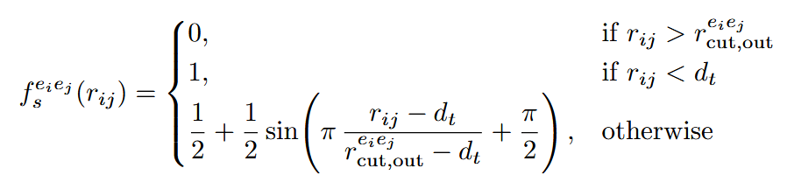
Smoothing functions
Smoothing functions are functions that can be multiplied into another function to taper the output to a constant value, usually zero. They can be used to make a problem unbounded, which is computationally simpler. This allows you to to easily ignore “out of range” properties that are negligible
A common requirement for an ideal smoothing function is that it is continuously differential along the cutoff point, sometimes several times.
The original 2017 smoothing function was cubic, while the 2024 smoothing function is tersoff

Slide 8
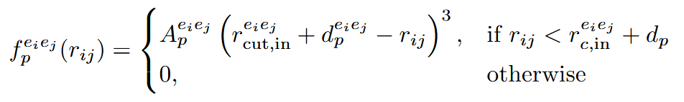

Penalty Function
The penalty function ensures that no two bodies get too close to each other. $A_{p}$ is the strength and $d_{p}$ is a parameter that dictate where the penalty function is activated

Slide 9
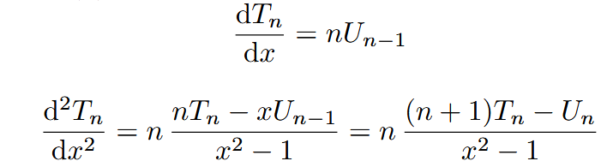
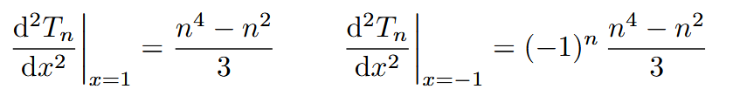

Derivatives of the Chebyshev polynomials
Derivatives of the first form of Chebyshev polynomials are needed because $f=−∇U$. They can be calculated using the left formulas.
Using L’Hopital’s allows you to evaluate the second derivative at its poles, shown on the right

Slide 10
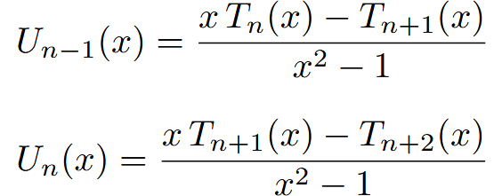
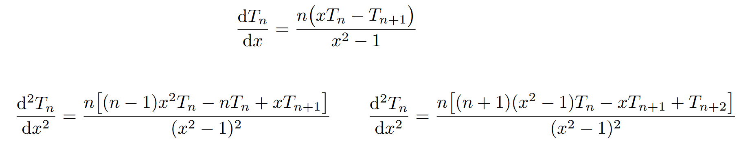
Alternative to the 2nd Chebyshev Polynomials
If it is undesirable to calculate the second form of Chebyshev polynomials, then the following substitutions can be used to get derivative expressions only in terms of T

